Slide 1

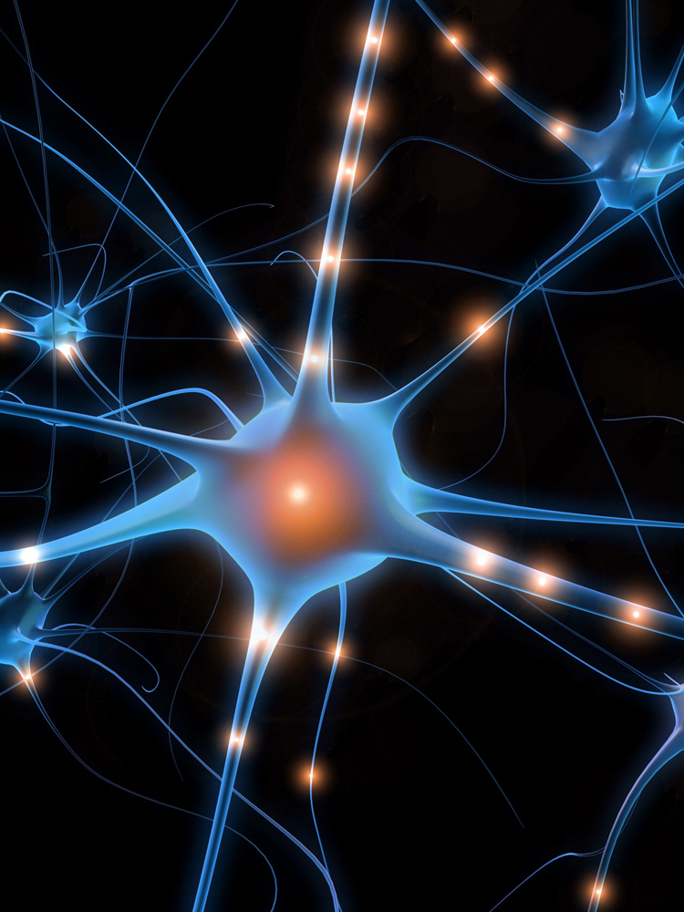


Neuroscience Spring Event 2015
Illuminating Neuroscience
Monday March 16th 2015
Building 85/Highfield Campus, UoS
Plenary Session
1-3 pm room 2207
Invited Speakers:
Dr Gero Miesenböck
Waynflete Professor of Physiology
Director, Centre for Neural Circuits and Behaviour University of Oxford
Dr Michael H. Hastings, FRS, FMedSci
Joint Head of Division,
Division of Neurobiology
MRC Laboratory of Molecular Biology, Cambridge
Scientific Poster Presentations
3 pm Level 6/7 Observatory
→southampton.ac.uk/SoNG←

