Slide 1


NHS Cancer Vaccine Launch Pad (CVLP)
NIHR Associate Principal Investigator (PI)
Scheme - Toolkit

Slide 2
Contents
Aims of the Associate PI Scheme
Structure of the Associate PI Scheme
Benefits of the Associate PI Scheme
Associate PI Scheme – Endorsements
Who can join the Associate PI Scheme (CVLP)
What is The CVLP
What is a Cellular Pathology Genomics Centre?
What is a Personalised Cancer Vaccine?
Associate PI Scheme - Trainee Process
Associate PI Scheme – Checklist Activities
Further information

Slide 3
Aims of the Associate PI Scheme
To integrate clinical research into clinical training
To develop doctors, nurses, and healthcare professionals to be the PIs of the future
To engage, recognise, and promote healthcare professional engagement in NIHR portfolio research, consistently
To increase opportunities for patients to be involved in high quality research to ultimately improve care

Slide 4
Structure of the Associate PI Scheme
Open to any health and care professional who is not currently fully funded to work in research, and is willing to make a significant contribution to the conduct and delivery of a study at a local level
Participation in the Associate PI Scheme does not absolve local PIs of their legal responsibilities at site
Commitment of at least 6 months to complete the checklist of activities required for gaining Associate PI status
There is no funding associated with the Associate PI Scheme. Applicants will take part in the Scheme alongside performing their core role
Applicants must register prospectively - retrospective recognition is not supported

Slide 5
Benefits of the Associate PI Scheme
For the Associate PI
Experience of research with the oversight of the local enthusiastic PI
Learns about the challenges and practicalities of delivering a portfolio study
Evidenced activity via the Checklist
Participation is recognised through certification for their training portfolio
Portfolio Career benefits
Associate PIs will be acknowledged in the primary publication(s) from the study
For the PI
Additional support with the delivery of the study
Developing the PIs of the future
For Study Team/CTU
Increased support for the trial at sites - managing delegation logs, etc.
Increased Data Quality
Speedier Delivery
Enhanced Recruitment
For the Patients
Increased opportunities to be involved in high-quality research

Slide 6
Associate PI Scheme – Endorsements
The Scheme is endorsed by the NIHR Clinical Research Network, and the following Royal Colleges:
Royal College of Physicians
Royal College of Radiologists
Royal College of Surgeons (England)
Royal College of Pathologists
Royal College of Nursing
Council for Allied Health Professions Research

Slide 7
Who can join the Associate PI Scheme (CVLP)
    Applicants can only be an Associate PI for the CVLP and not concurrently with another study
    There can only be one Associate PI trainee per CVLP site.
    Not eligible if your role is specifically funded to work on research
    Associate PI Trainees must be able to commit to 6 months of working on a study at their site
    Applicants must gain prior approval from their Local PI

Slide 8
What is the NHS Cancer Vaccine Launch Pad (CVLP) ?
The aim of the CVLP is to establish the feasibility of patient referral and tissue pathway to enable NHS patients with cancer to access cancer vaccine trials.
NHS England is the research sponsor with the day-to-day management coordinated through by the Cancer Research UK Southampton Clinical Trials Unit (SCTU).
Study design:
Patients will consent to be referred to a cancer vaccine trial and for surplus tissue samples, obtained through standard of care pathways, to be used to assess their eligibility for current cancer vaccine trials run by trial sponsors.
The pathway requires collaboration between Surgeons, Pathologists, Oncologists, Clinical Nurse Specialists, and local CVLP Research Teams to run successfully.

Slide 9
What is the NHS Cancer Vaccine Launch Pad (CVLP) ?
The first trial sponsor the CVLP is supporting is BioNTech SE with their BNT122-01 Phase II adjuvant colorectal cancer vaccine trial.
CVLP sites are identifying, consenting and referring patients potentially suitable for BNT122-01 to the nearest hospital delivering the trial.
The CVLP also incorporates elements of the NHS Genomic Medicine Service by utilising a network of Cellular Pathology Genomic Centres (CPGCs) across England to handle and process high quality samples for genetic analysis and vaccine manufacture.

Slide 10
What is a Cellular Pathology Genomic Centre (CPGC)?
Additional resource to improve and streamline tumour tissue handling and processing is required to meet the increasing demand for molecular and genetic diagnostics.
CPGCs have been developed as centres of excellence for tissue sample handling and preparation to facilitate the high-quality molecular testing required for the manufacture of personalised cancer vaccines.
The CVLP is the first project to utilise the CPGC network and relies heavily on the service CPGCs provide.
The CPGC network also allows for tissue processing and transfer across pathology network borders not typically performed for routine diagnostic work.

Slide 11
What is a Personalised Cancer Vaccine?
Personalised cancer vaccines are a type of cancer treatment designed to target an individual's unique cancer cells. They are created by analysing a patient's tumour and identifying specific mutations that are unique to that cancer, then using that information to create a vaccine tailored to that patient. The intention is that the vaccine will stimulate the immune system to specifically recognise and destroy the cancer cells.
Newer cancer vaccines are based on messenger RNA (mRNA) technology. Unlike traditional vaccines, which contain dead or weakened forms of disease-causing agents, mRNA vaccines contain instructions for the body's own cells to produce a protein that is found in a patient's cancer cells.
Personalised cancer vaccines are in the experimental stages, with phase 2 and 3 studies required to determine their safety and efficacy.

Slide 12


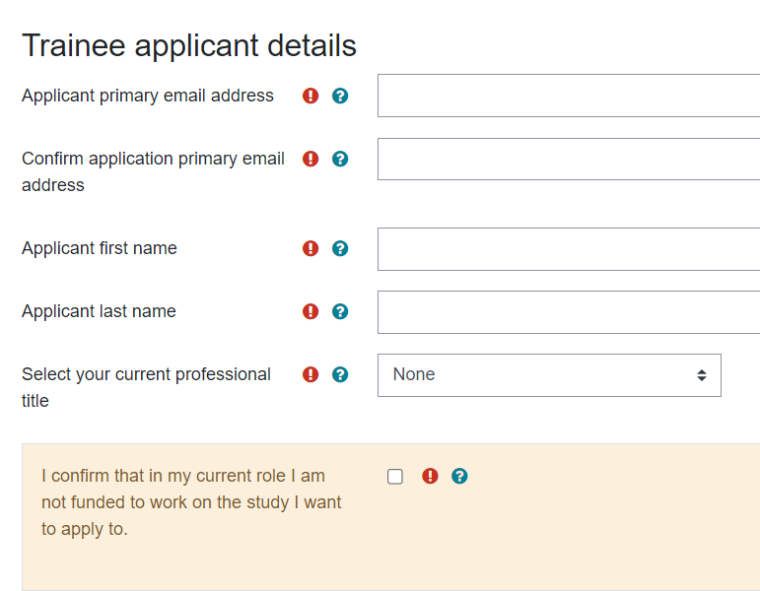
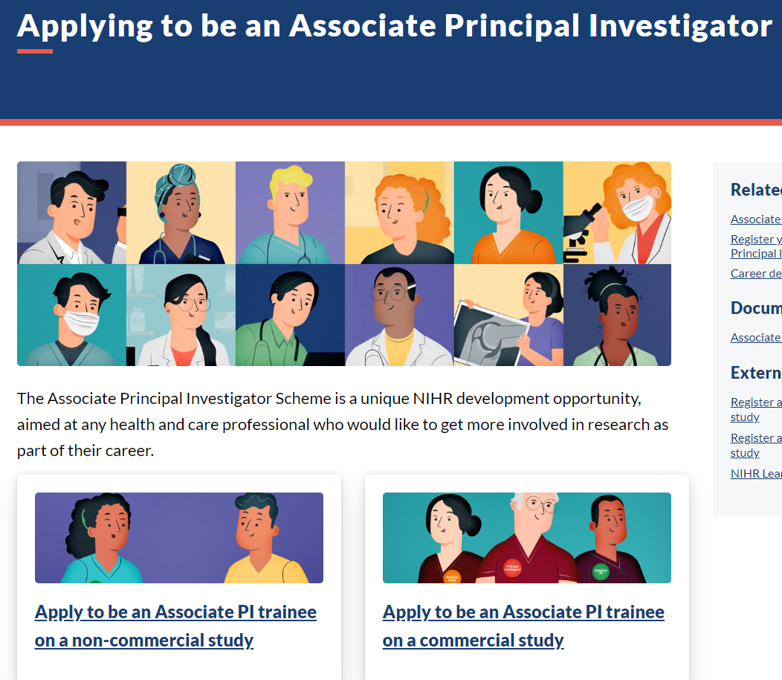
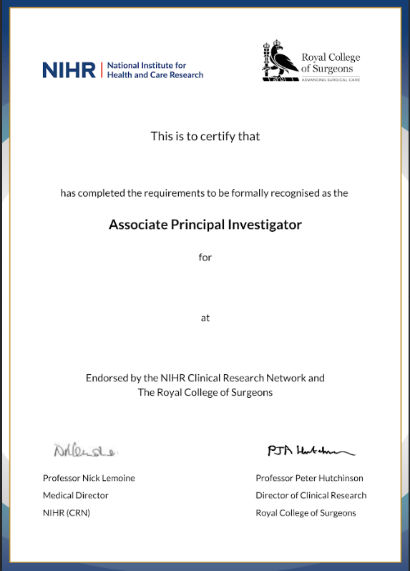
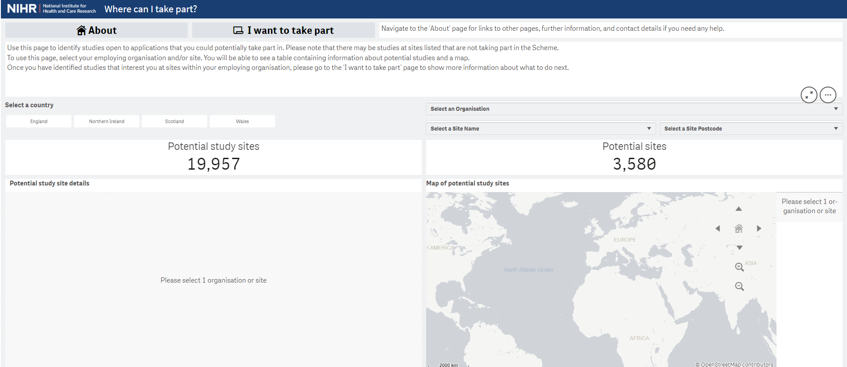
Associate PI Scheme Trainee process
Check your eligibility
Find a study
Complete the Application form
Access to online learning
Complete Associate PI Checklist
Certificate awarded
Before you begin, check you meet the trainee eligibility criteria - Full details can be found on the NIHR Associate PI Scheme Website:
www.NIHR.ac.uk/AssociatePIScheme
To identify a study that is registered onto the Associate PI Scheme and open to recruitment at your local site, visit the Associate PI Scheme dashboard, and the ‘Where can I Take Part?’ tool.
Applicants must gain prior approval from their Local PI.
Complete and submit the Associate PI Trainee application form.
Once successfully registered onto the Scheme, you will be given access to the Associate PI Scheme Learning Pathway in NIHR Learn.
The Associate PI Trainee works alongside their Local PI for 6 months.
The Local PI acts as a mentor during their time on the Scheme.
The Associate PI trainee fills in their checklist as they go, and completes the Associate PI Scheme Learning Pathway in NIHR Learn.
The Checklist gets signed off by Local PI and National Study Coordinator.
The Associate PI trainee must then Submit their completed and fully signed Checklist.
Certificate is issued, officially confirming ‘Associate PI’ status.

Slide 13
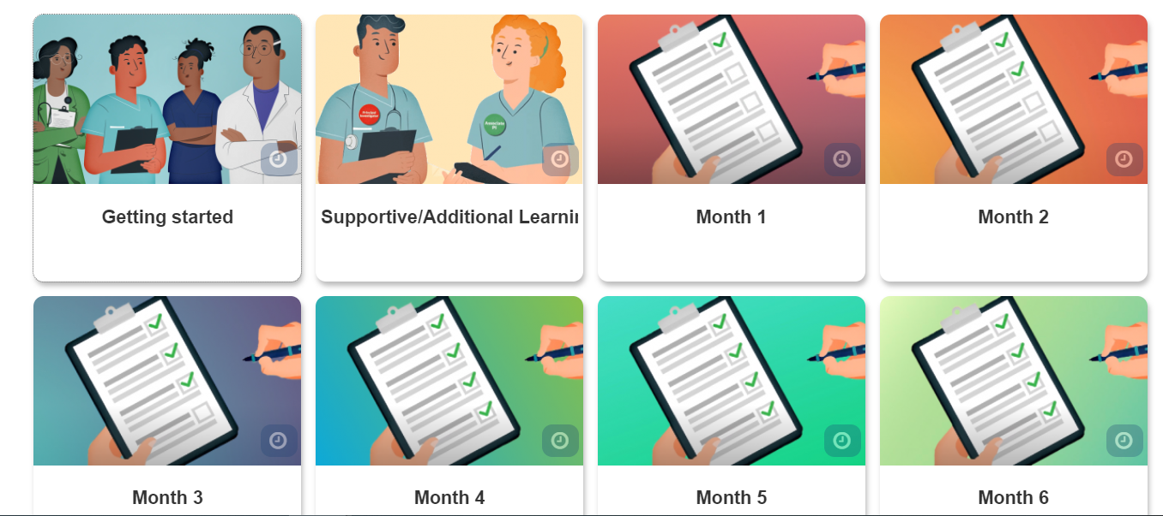
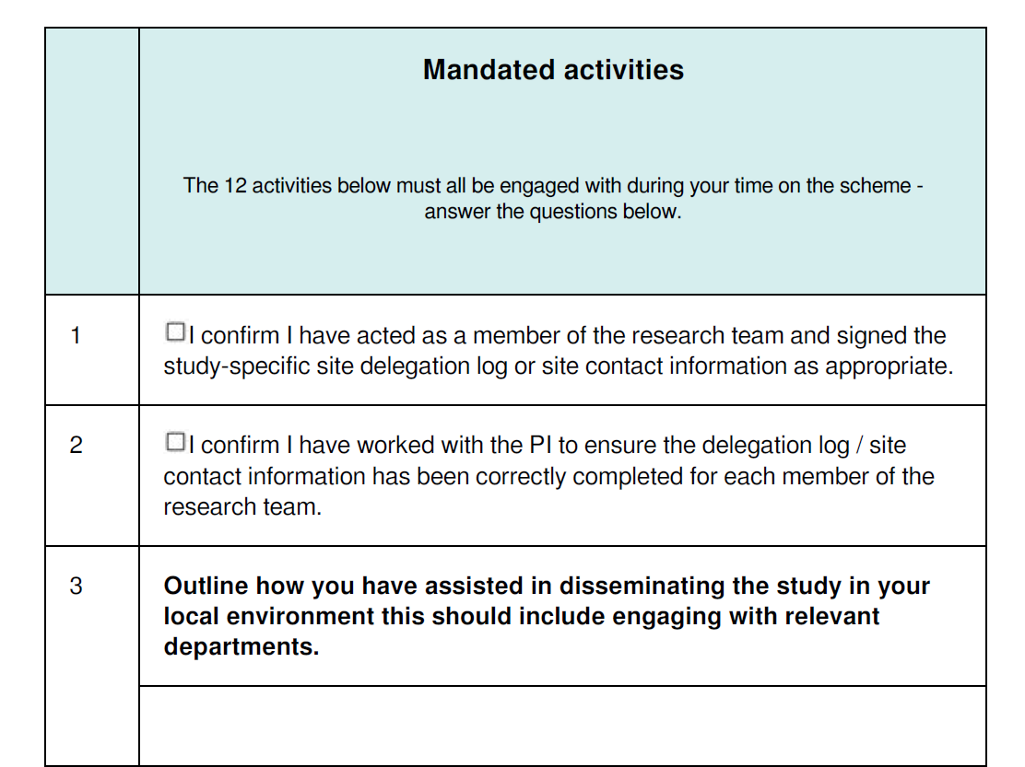
Associate PI Scheme - Checklist Activities
What does the Checklist cover?
Signature on study-specific delegation log
Dissemination to the department
Engagement with staff, research team meetings (Diary of research team meetings)
Site log, protocol amends, data returns and quality
Train staff (GCP, protocol)
Screening logs, recruitment/consent of patients or facilitating consent of patients
Deputising for PI
PPI activities
Activity is evidenced via an online Checklist hosted on NIHR Learn

Slide 14



For further information,
visit the website at
www.NIHR.ac.uk/AssociatePIScheme
or scan the QR code below

